Slide 1

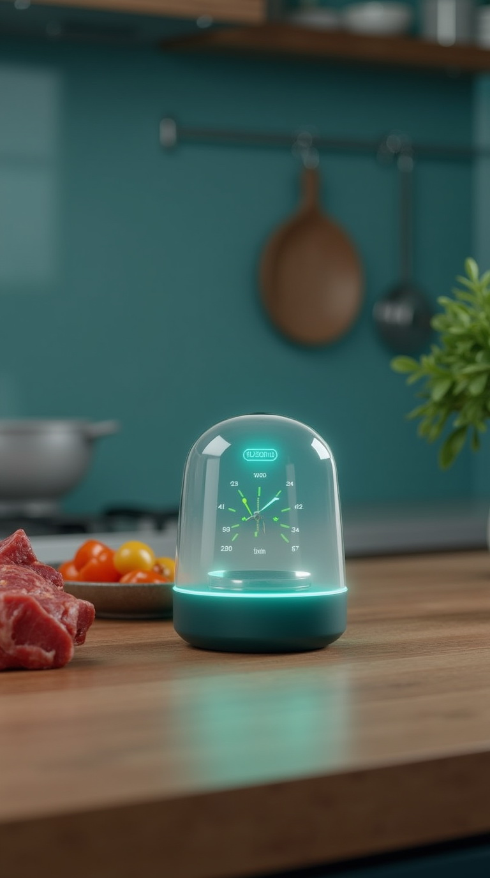

AromaTech Smart Kitchen Freshness Sensor
Smell your food – with science.
Affordable, accurate freshness analyzer for everyday kitchens.

Slide 2
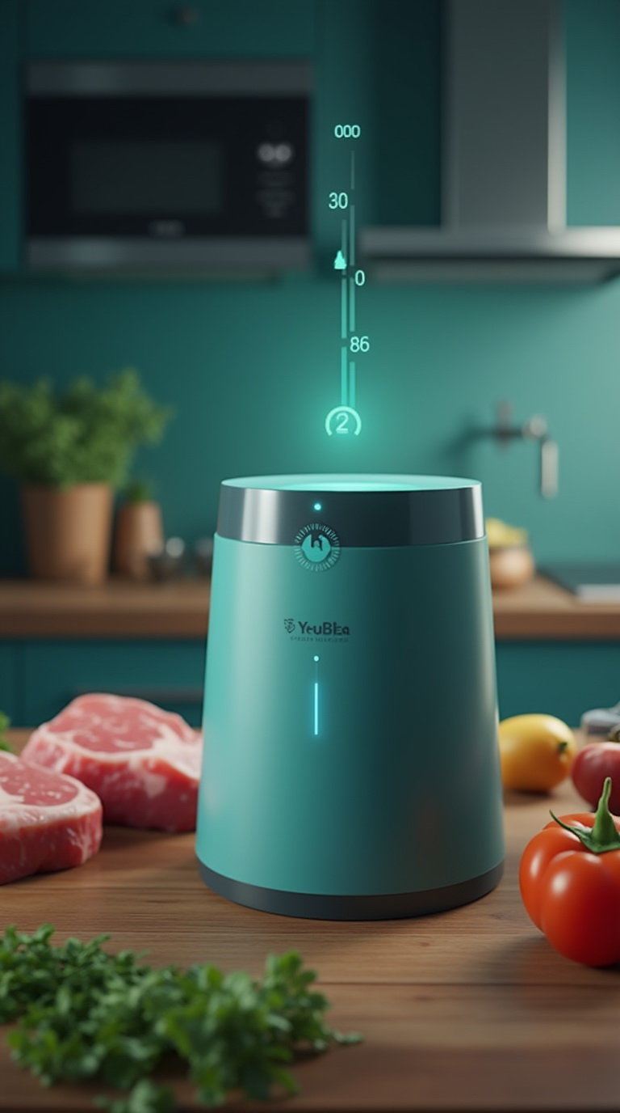
What is AromaTech?
A compact thermodynamic multi-gas sensor for home kitchens.
Detects food freshness by analyzing odor and gas composition.
Ideal for meat, fish, produce, and leftovers.

Slide 3

The Problem
Consumers can't reliably judge freshness of stored food.
Appearance or smell is subjective – and risky.
No affordable tools exist to measure spoilage accurately.

Slide 4

Our Solution
AromaTech reads real gas patterns released by food.
Provides a digital score from 1 (spoiled) to 10 (very fresh).
Different foods and regions have unique profiles – we track them.

Slide 5
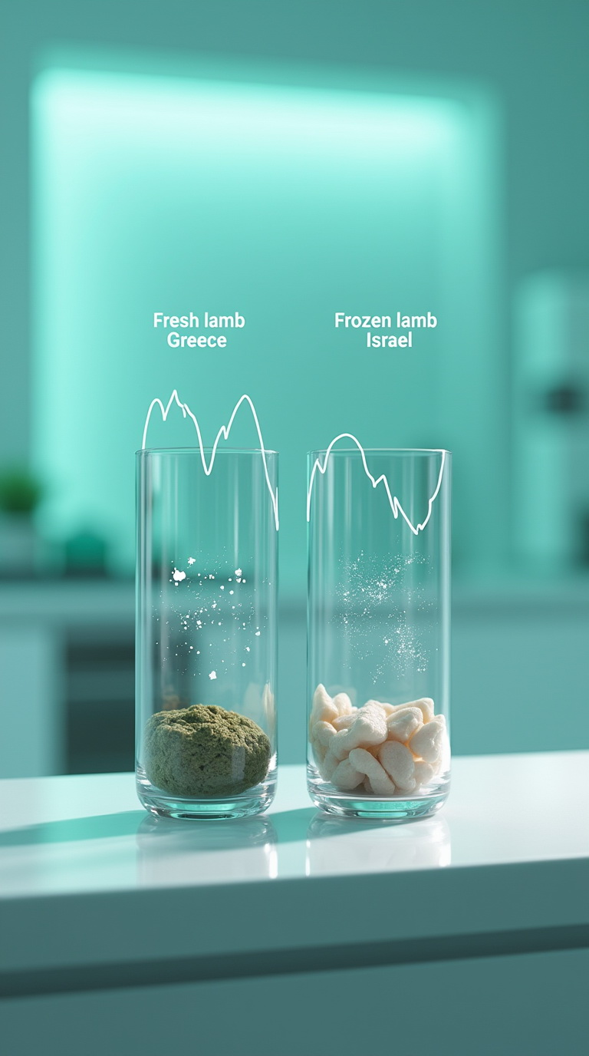
Unique Features
Calibrated for non-equilibrium air (real kitchen conditions).
Smell-trained for dozens of food types (meat, fish, dairy).
Recognizes regional aroma variations: Mutton in the freezer is different from fresh lamb. And lamb in Greece is different from in Israel.

Slide 6
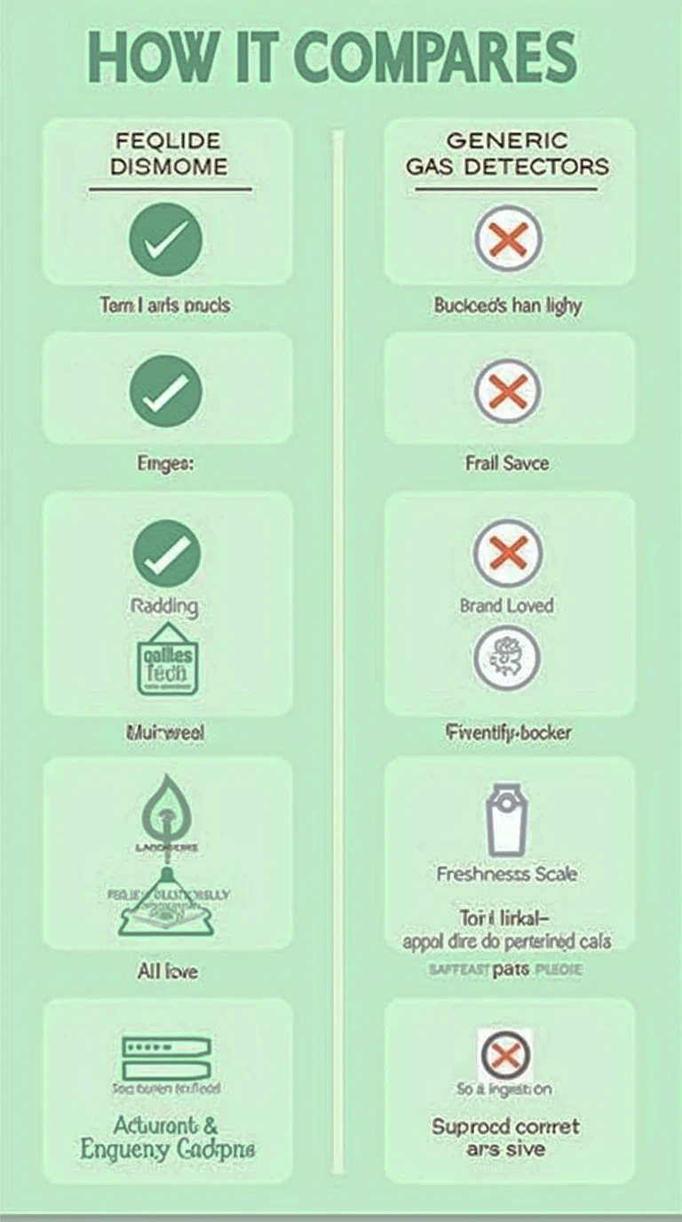
How It Compares
Much more accurate than generic VOC gas detectors.
Does what no other kitchen gadget can: smell like a human, report like a lab.
Gives clear guidance: safe to eat or not.

Slide 7

Price Advantage
Professional-grade accuracy for €90–150.
Cheaper than most digital detectors (€300–600).
5–10x lower cost than lab analyzers (€1,500+).

Slide 8

Target Audience
Home cooks and health-conscious families.
Seniors or caregivers ensuring food safety.
Meal-prep enthusiasts, food bloggers, small kitchens.

Slide 9

The Future of Home Food Safety
Smell becomes digital – and reliable.
FoodTech bridges science and everyday use.
Join the smart kitchen revolution today.

Slide 10

1. Vladyslav Vlastopulo SEO, Director of Harvard Marine, professor-consultant, Doctor of technical sciences in mechanical engineering, creator of the thermo-elastohydrodynamic theory of lubrication of heavily loaded plain bearings, author of a number of well-known works Elastohydrodynamic theory of lubrication of knee and hip implants, well-known Eslengen Tribological Academy, student of Fedor Snegovsky, currently specializing in tribological, ecological and biomedical engineering. Scientific director of the project.
2. Igor Chaadaev Research engineer, experiment director, artificial intelligence programmer, electronics engineer, microcontroller programmer, gas analyzer equipment developer.
3. Andrey Lukashenko Mathematician, biophysics air engineer.
FOUNDER

Slide 11
4. Vitaly Svirida Senior researcher, electronics engineer, microcontroller programmer, developer of gas analyzer equipment.
5. Sergey Nesterenko Senior researcher, research engineer, experiment director, electronics engineer, microcontroller programmer, developer of gas analyzer equipment.
6. Marina Noskova Biophysics air engineer. Gas Analysis Codivirus Method for Detecting the Threshold of Contagiousness and Therapy Adjustment
OTHERS DEVELOPERS

Slide 12

List of participants
Participant No. * | Organisation name | Country
1. Coordinator | Harvard Marine LLC | Ukraine
Email: vlastopulo0722@gmal.com Phone: +380-996776823 | CPMA group | Czech Republic

