Slide 1

Digital Gas Analyzer for Food Industry
Smell Under Control.
Taste in Numbers.

Slide 2
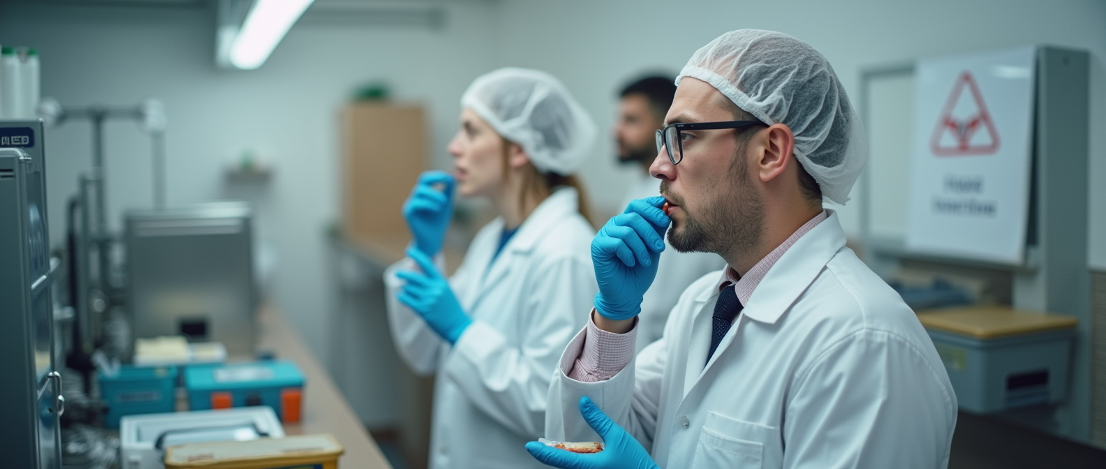
Problem & Need
Subjective aroma/taste evaluations
Complex supply chains and storage conditions
Stricter EU food safety standards

Slide 3

Our Solution
Compact Digital Gas Analyzer for Odor & Taste Profiling
Measures 3 gases including CO₂
Compensates for temperature and humidity
Converts odor into taste profiles

Slide 4

STRENGTHS AND DIFFERENCES
Thermodynamic digital multigas food analyzers differ from all others in that:
1. Protarized by the main gases that make up air as a non-equilibrium system.
2. Protarized by the odor of the product from conditioned to spoiled on a scale from 1 to 10.
And lamb in the freezer differs from lamb fresh, and lamb in Greece differs from lamb in Israel.

Slide 5

Key Advantages
Matchbox-sized — ideal for field or lab use
Quantitative analysis of aroma
Perfect for premium food products
IoT integration ready
Standardizes product flavor

Slide 6

Application Areas
Food manufacturing (QA/QC)
Logistics and storage monitoring
Certification and compliance labs
R&D in product development

Slide 7
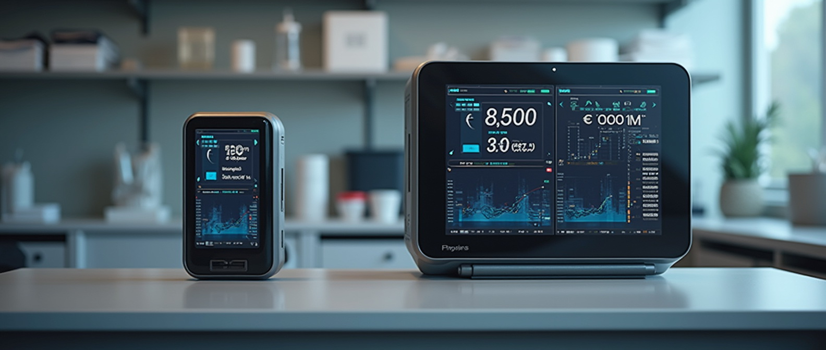
Product Range & Pricing
Portable version: From €1,500
Stationary lab system: From €8,000
Competitive pricing with precision

Slide 8

Why It Matters
"Taste begins with smell — and we digitize it."
A new standard in flavor monitoring for premium food sector

Slide 9

1. Vladyslav Vlastopulo
SEO, Director of Harvard Marine, professor-consultant, Doctor of technical sciences in mechanical engineering, creator of the thermo-elastohydrodynamic theory of lubrication of heavily loaded plain bearings, author of a number of well-known works Elastohydrodynamic theory of lubrication of knee and hip implants, well-known Eslengen Tribological Academy, student of Fedor Snegovsky, currently specializing in tribological, ecological and biomedical engineering. Scientific director of the project.
2. Igor Chaadaev
Research engineer, experiment director, artificial intelligence programmer, electronics engineer, microcontroller programmer, gas analyzer equipment developer.
3. Andrey Lukashenko
Mathematician, biophysics air engineer.
FOUNDER

Slide 10
4. Vitaly Svirida
Senior researcher, electronics engineer, microcontroller programmer, developer of gas analyzer equipment.
5. Sergey Nesterenko
Senior researcher, research engineer, experiment director, electronics engineer, microcontroller programmer, developer of gas analyzer equipment.
6. Marina Noskova
Biophysics air engineer. Gas Analysis Codivirus Method for Detecting the Threshold of Contagiousness and Therapy Adjustment
OTHERS DEVELOPERS

Slide 11
1. https://www.who.int/news-room/q-a-detail/q-a-coronaviruses.
2. Kohn, W. G. et al. Guidelines for infection control in dental health-care settings-2003. MMWR Recomm. Rep. 52, 1–61 (2003).
3. Tang, J. W., Li, Y., Eames, I., Chan, P. K. & Ridgway, G. L. Factors involved in the aerosol transmission of infection and control of ventilation in healthcare premises. J. Hosp. Infect. 64, 100–114 (2006).
4. Fennelly, K. P. et al. Cough-generated aerosols of Mycobacterium tuberculosis: a new method to study infectiousness. Am. J. Respir. Crit. Care Med. 169, 604–609.
5. Dzemal Elezagic, Wibke Johannis, Volker Burst, Florian Klein and Thomas Streichert. Venous blood gas analysis in patients with COVID-19 symptoms in the early assessment of virus positivity. From the journal Journal of Laboratory Medicine/. https://doi.org/10.1515/labmed-2020-0126
6. Chen, L. et al. Detection of 2019-nCoV in Saliva and Characterization of Oral Symptoms in COVID-19 Patients. https://ssrn.com/abstract=3557140 (2020).
7. Vlastopulos V.I., Plenary Lecture 2: «Creation of Electromagnetic Structure-Creating Spaces to Improve the Growth of Some Types of Cells and Albumins». (BIO’09) ISBN: 978-960-474-141-0, ISSN: 1790-5125
8. Vlastopulos V.I., Nikolaev V.G., Bioenergetic fields of the human brain rhythmus. The using in video, audio products for the creating attracted bioenergetic advertisement, article №9B1840, materials of conference EBSA2009, conducted since 11 to 15 July in Genoa, Italy, 2009.
9. Equations of Thermodinamics for Expansion and Filling by Human Civilization. Vlastopulo.V.I.¹, Polichronidi.A.G² IJ0ER-N0V-1.
REFERENCES

Slide 12
Participant No. * | Organisation name | Country
1 (Coordinator) | Harvard Marine LLC | Ukraine
 | CPMA group | Czech Republic
LIST OF PARTICIPANTS

Slide 13
Email: vlastopulo0722@gmal.com
Phone:
+380-996776823
CONTACTS

