Slide 1


Thermodynamic
Multi-Gas Odor Analyzer
Innovative Solution for Grain Storage Monitoring
Our project focuses on advanced gas detection to ensure grain storage quality and safety.

Slide 2


The Problem:
Why Early Detection Matters
Grain losses are a major economic issue
Early detection of spoilage is critical
Traditional methods are insufficient
Grain storage losses result in significant economic impact. Early identification of spoilage, bioactivity, and pests is crucial, yet conventional monitoring methods often lack sensitivity, detecting issues only when damage is already substantial and harder to reverse.

Slide 3
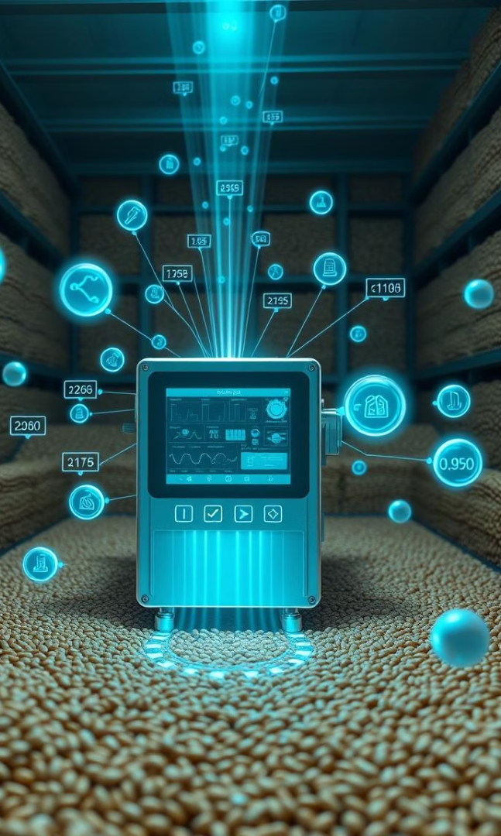
What is a Multi-Gas
Odor Analyzer?
Simultaneous Measurement
Measures multiple gas concentrations at once.
Comprehensive Odor Profile
Creates a detailed snapshot of the storage environment.
Proactive Detection
Identifies issues before visible spoilage appears.

Slide 4






Key Gas Indicators
Specific gases signal different types of issues.
Methane (CH₄)
Hydrogen Sulfide (H₂S)
Ammonia (NH₃)
Anaerobic fermentation, poor ventilation.
Protein breakdown, urea decomposition.
Organic decay, anaerobic bacteria.
Carbon Dioxide (CO₂)
Hydrogen (H₂)
Microbial and insect respiration.
Fermentation, bioactivity.

Slide 5
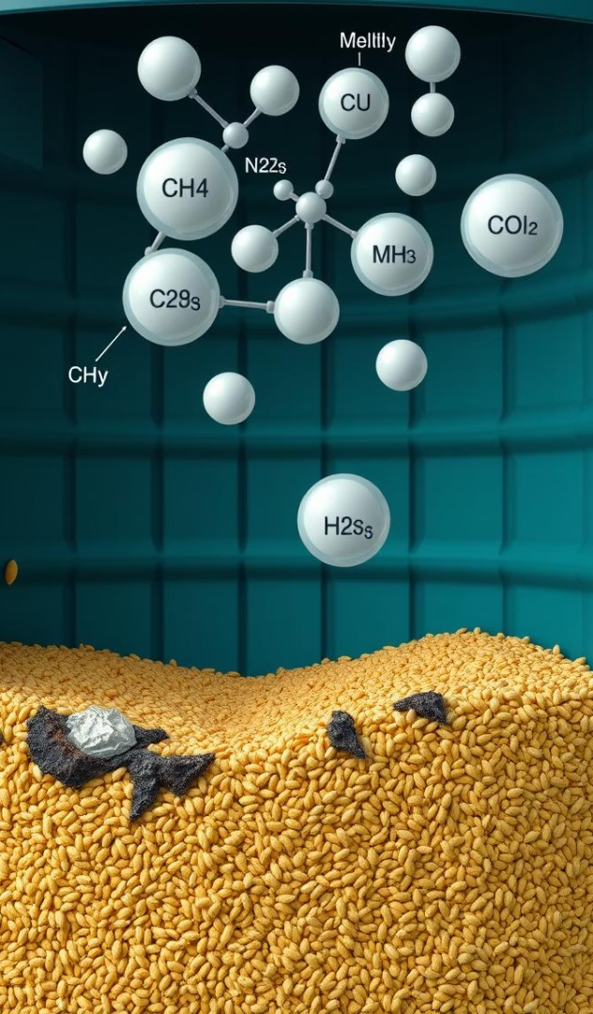
Spoilage, Mold, and Anaerobic Processes
Detecting specific gases allows for early intervention, preventing widespread spoilage.
1
Methane & H₂S
Signal poor ventilation, decaying processes.
2
Ammonia & CO₂
Indicate protein breakdown, mold growth.
3
Prevent Spoilage
Early detection prevents large-scale losses.

Slide 6





Bioactivity and Dry Matter Loss
CO₂ as Main Indicator
Signifies metabolic activity in grain, microbes, insects.
Hydrogen Signals Fermentation
Indicates active biochemical processes.
Ammonia for Protein Breakdown
Additional marker for decay.
Preventing Quality Loss
Monitoring prevents quality and mass reduction.

Slide 7

Rodent Presence (Rats, Mice)
Metabolite Challenge
Odor Profile
Direct rodent gas metabolites are difficult to isolate.
Ammonia and specific VOCs (urine, feces, pheromones) form unique patterns.
AI Detection
AI models analyze VOC patterns for early rodent detection.

Slide 8

Why Choose the Thermodynamic Multi-Gas Odor Analyzer?
Protect Your Profits and Reputation!
Minimize grain losses: Detect spoilage, bioactivity, and pests at the earliest stage — before they cause serious damage.
Stay ahead of problems: Continuous, real-time monitoring provides instant alerts, enabling fast and effective intervention.
Ensure quality and safety: Maintain optimal storage conditions, preserve grain quality, and meet strict food safety standards.
Save time and resources: Automated analysis reduces manual inspections and human error.
Future-proof your business: Adopt cutting-edge technology trusted by industry leaders and backed by scientific research.
Invest in confidence, efficiency, and peace of mind —
choose the Multi-Gas Odor Analyzer today!

Slide 9

Founder
1. Vladyslav Vlastopulo
Director of Harvard Marine, professor-consultant. Doctor of technical sciences, author of a number of well-known works, currently specializing in tribological, ecological and biomedical engineering. Scientific director of the project.
2. Igor Chaadaev
Research engineer, experiment director, artificial intelligence programmer, electronics engineer, microcontroller programmer, gas analyzer equipment developer.
3. Olga Tsaprika
Marketing.
4. Andrey Lukashenko
Mathematician, biophysics air engineer.
5. Victor Michaylov
SAAS programmer, IT specialist.

Slide 10

List of participants
Participant No. * | Organisation name | Country
1 (Coordinator) | Harvard Marine LLC | Ukraine
Contacts
Email: vlastopulo0722@gmal.com
Phone:
+380-996776823

