Slide 1

Digital Gas Analyzer for Food Industry
Smell Under Control.
Taste in Numbers.

Slide 2
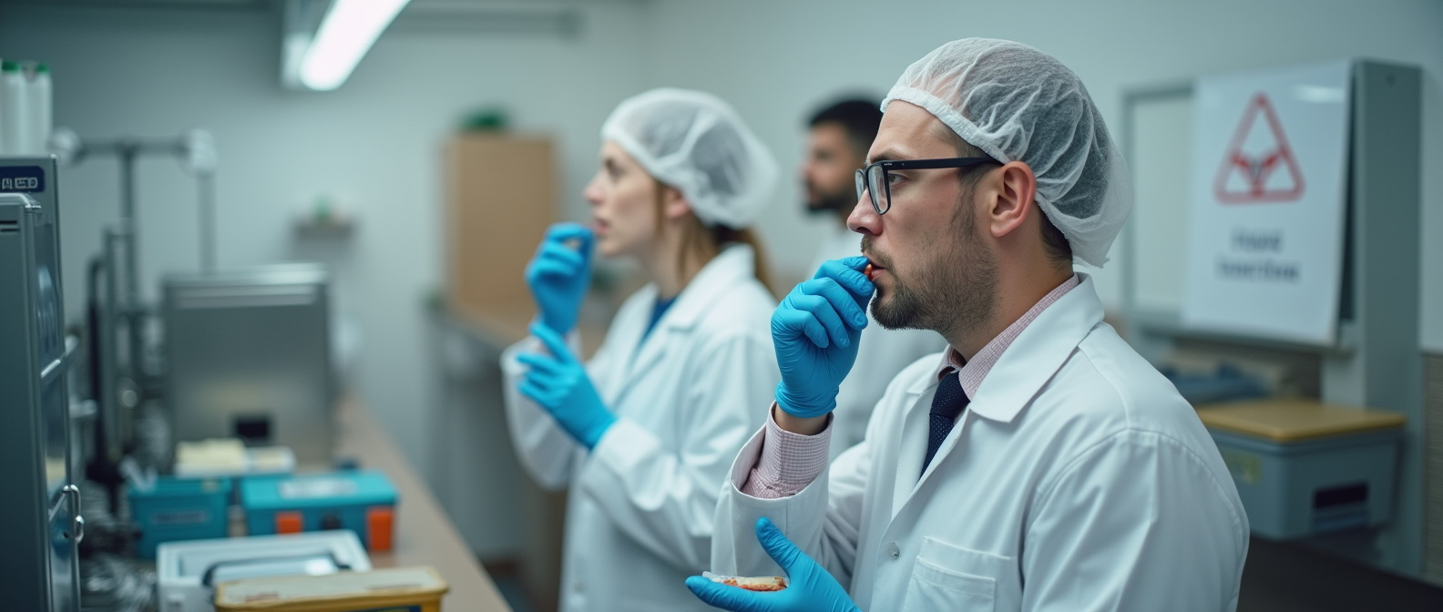
Problem & Need
Subjective aroma/taste evaluations
Complex supply chains and storage conditions
Stricter EU food safety standards

Slide 3

Our Solution
Compact Digital Gas Analyzer for Odor & Taste Profiling
Measures 3 gases including CO₂
Compensates for temperature and humidity
Converts odor into taste profiles

Slide 4

STRENGTHS AND DIFFERENCES
Thermodynamic digital multigas food analyzers differ from all others in that:
1. Protarized by the main gases that make up air as a non-equilibrium system.
2. Protarized by the odor of the product from conditioned to spoiled on a scale from 1 to 10.
And lamb in the freezer differs from lamb fresh, and lamb in Greece differs from lamb in Israel.

Slide 5

Key Advantages
Matchbox-sized — ideal for field or lab use
Quantitative analysis of aroma
Perfect for premium food products
IoT integration ready
Standardizes product flavor

Slide 6

Application Areas
Food manufacturing (QA/QC)
Logistics and storage monitoring
Certification and compliance labs
R&D in product development

Slide 7
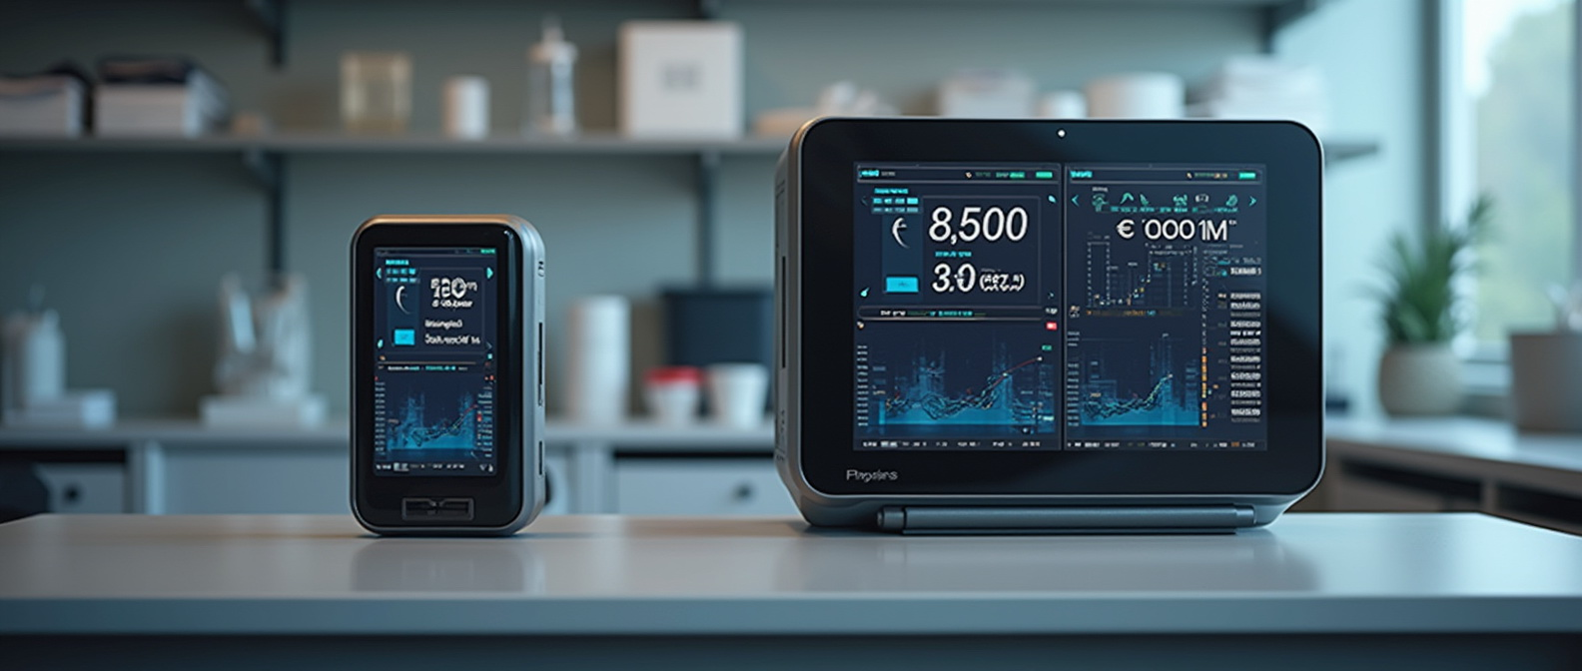
Product Range & Pricing
Portable version: From €1,500
Stationary lab system: From €8,000
Competitive pricing with precision

Slide 8

Why It Matters
"Taste begins with smell — and we digitize it."
A new standard in flavor monitoring for premium food sector
Monetization Model
• Device sale: from €6,000 per unit
• Annual analytics software subscription: €500 per device
• Annual maintenance & calibration: €300
• Future model: licensing and franchising for international scale-up

Slide 9
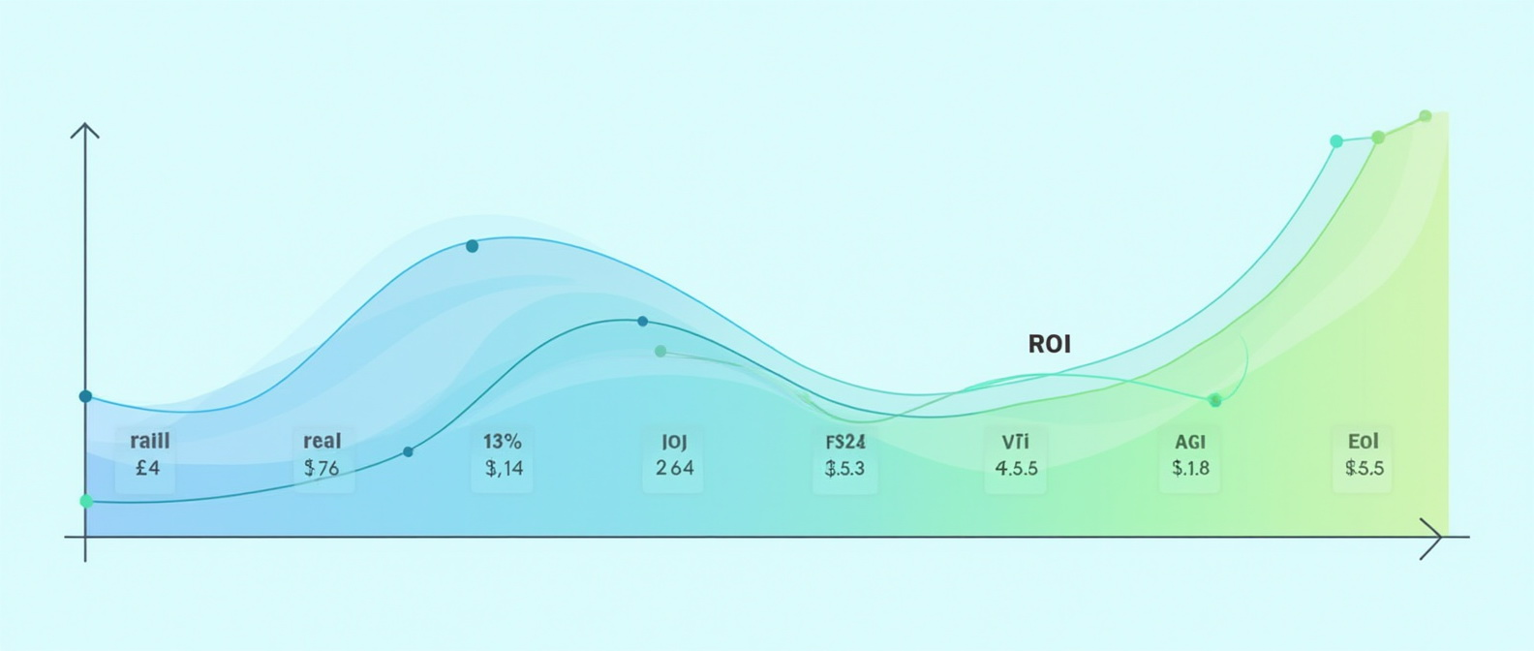
Forecast (ROI)
Metric | Value
Production cost per unit | €2,000
Selling price | €6,000
Planned sales (Year 2) | 100 units
Revenue (Year 2) | €600,000
Estimated profit | €350,000
Payback period | 12–16 months
Revenue Forecast (RO)

Slide 10

1. Vladyslav Vlastopulo
Director of Harvard Marine, professor-consultant. Doctor of technical sciences, author of a number of well-known works, currently specializing in tribological, ecological and biomedical engineering. Scientific director of the project.
2. Igor Chaadaev
Research engineer, experiment director, artificial intelligence programmer, electronics engineer, microcontroller programmer, gas analyzer equipment developer.
FOUNDER

Slide 11

3. Andrey Lukashenko
Mathematician, biophysics air engineer.
4. Vitaly Svirida
Senior researcher, electronics engineer, microcontroller programmer, developer of gas analyzer equipment.
5. Sergey Nesterenko
Senior researcher, research engineer, experiment director, electronics engineer, microcontroller programmer, developer of gas analyzer equipment.
6. Marina Noskova
Biophysics air engineer. Gas Analysis Codivirus Method for Detecting the Threshold of Contagiousness and Therapy Adjustment
OTHERS DEVELOPERS

Slide 12

Participant No. * | Organisation name | Country
1 (Coordinator) | Harvard Marine LLC | Ukraine
 | CPMA group | Czech Republic
LIST OF PARTICIPANTS

Slide 13

Email: vlastopulo07222@gmal.com
Phone:
+380-996776823
CONTACTS

