Slide 1


Digital Gas Analyzer for Food Industry
Smell Under Control.
Taste in Numbers.

Slide 2
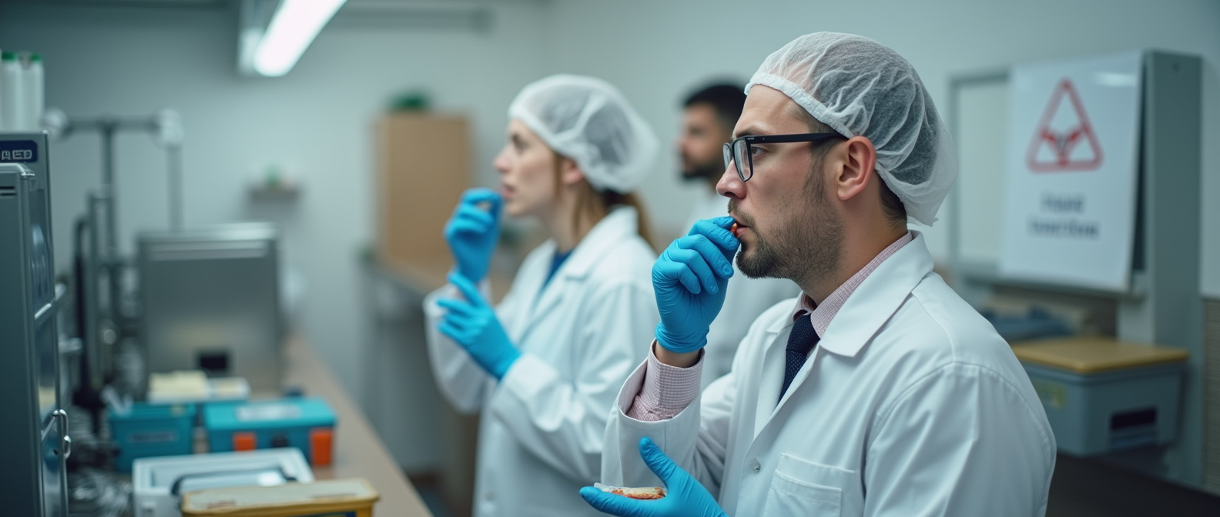

Problem & Need
Subjective aroma/taste evaluations
Complex supply chains and storage conditions
Stricter EU food safety standards

Slide 3

Our Solution
Compact Digital Gas Analyzer for Odor & Taste Profiling
Measures 3 gases including CO₂
Compensates for temperature and humidity
Converts odor into taste profiles

Slide 4
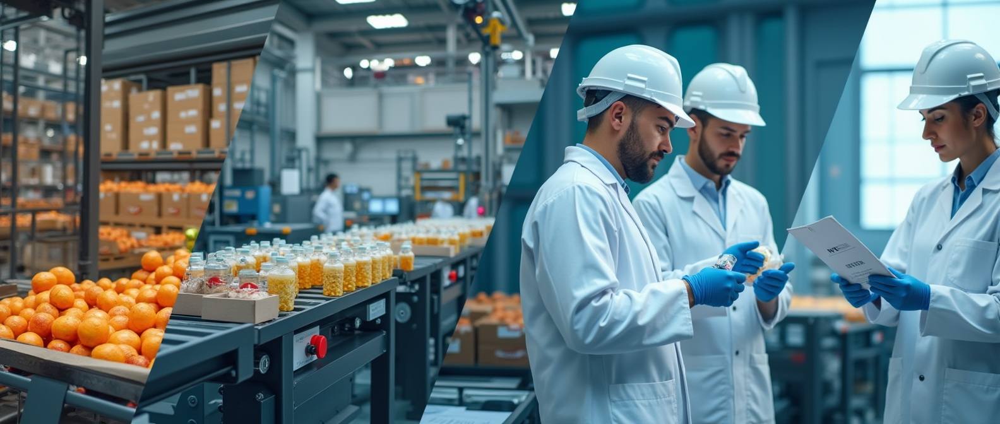
STRENGTHS AND DIFFERENCES
Thermodynamic digital multigas food analyzers differ from all others in that: 1. Protarized by the main gases that make up air as a non-equilibrium system. 2. Protarized by the odor of the product from conditioned to spoiled on a scale from 1 to 10. And lamb in the freezer differs from lamb fresh, and lamb in Greece differs from lamb in Israel.

Slide 5

Key Advantages
Matchbox-sized — ideal for field or lab use
Quantitative analysis of aroma
Perfect for premium food products
IoT integration ready
Standardizes product flavor

Slide 6
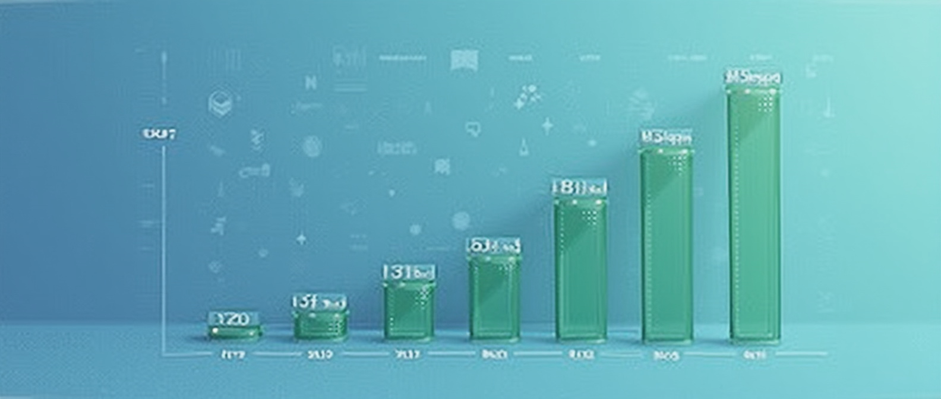
Work algorithm
Each substance has its own differential path dS Know-how and differential time dT Know-how, the propagation of a given molar substance in the air. This is the basis for the calibration of a given substance depending on its concentration and on the differentials of Conductivity dQ, Current dA, Resistance dR of a detector of a gas analyzer of a given type. The count is carried out on the basis of differentials of the path and the time of passage of a given molar mass in the air.
adc1 //Analog value from the detector coefV = 0.1875 //constant for ADC accuracy
d = 1000 //divider to obtain the value in volts
0.? //Constant derived empirically Know-how
V = 5 //5 volts detector power supply 10000 //divider to obtain Ohms
Ro = 122 //Resistance in clean air
Resistance in clean airAll data are combined into a system of nonlinear equations of thermodynamics of a nonequilibrium system.

Slide 7

Application Areas
Food manufacturing (QA/QC)
Logistics and storage monitoring
Certification and compliance labs
R&D in product development

Slide 8
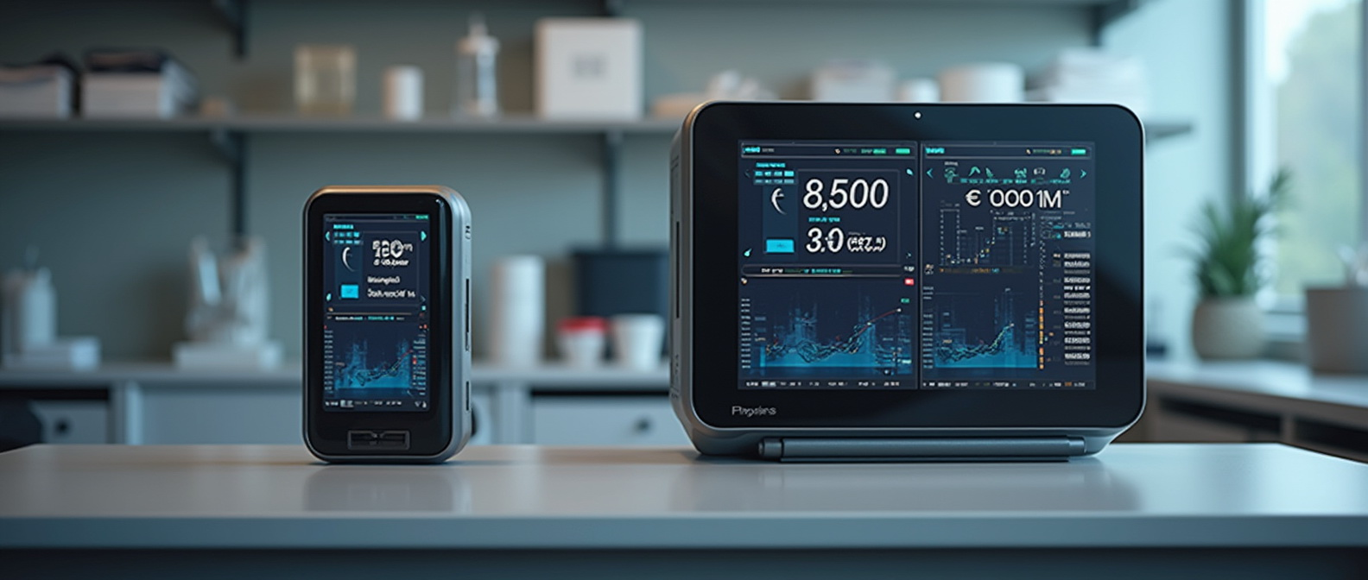
Product Range & Pricing
Portable version: From €1,500
Stationary lab system: From €8,000
Competitive pricing with precision

Slide 9

Why It Matters
"Taste begins with smell — and we digitize it."
A new standard in flavor monitoring for premium food sector
Monetization Model
• Device sale: from €6,000 per unit
• Annual analytics software subscription: €500 per device
• Annual maintenance & calibration: €300
• Future model: licensing and franchising for international scale-up

Slide 10
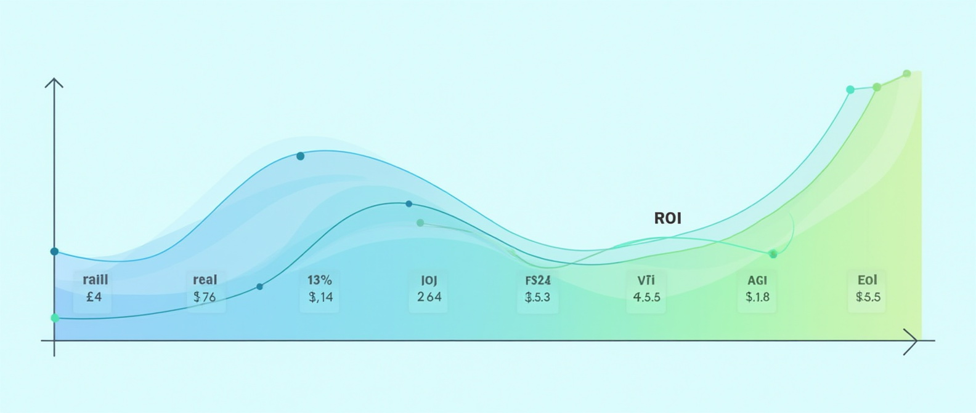
Forecast (ROI)
Metric | Value
Production cost per unit | €2,000
Selling price | €6,000
Planned sales (Year 2) | 100 units
Revenue (Year 2) | €600,000
Estimated profit | €350,000
Payback period | 12–16 months
Revenue Forecast (RO)

Slide 11

1. Vladyslav Vlastopulo Director of Harvard Marine, professor-consultant. Doctor of technical sciences, author of a number of well-known works, currently specializing in tribological, ecological and biomedical engineering. Scientific director of the project.
2. Igor Chaadaev Research engineer, experiment director, artificial intelligence programmer, electronics engineer, microcontroller programmer, gas analyzer equipment developer.
FOUNDER

Slide 12

3. Andrey Lukashenko Mathematician, biophysics air engineer.
4. Vitaly Svirida Senior researcher, electronics engineer, microcontroller programmer, developer of gas analyzer equipment.
5. Sergey Nesterenko Senior researcher, research engineer, experiment director, electronics engineer, microcontroller programmer, developer of gas analyzer equipment.
6. Marina Noskova Biophysics air engineer. Gas Analysis Codivirus Method for Detecting the Threshold of Contagiousness and Therapy Adjustment
OTHERS DEVELOPERS

Slide 13

Participant No. * | Organisation name | Country
1 (Coordinator) | Harvard Marine LLC | Ukraine
 | CPMA group | Czech Republic
LIST OF PARTICIPANTS

Slide 14

Email: vlastopulo07222@gmal.com
Phone: +380-996776823
CONTACTS

