Slide 1



Thermodynamic
Multi-Gas Odor Analyzer for Drug Detection
Prof. Vladyslav Vlastopulo
Harvard Marine LCC, Ukraine
Vlastopulo0722@gmail.com
+380996776823

Slide 2
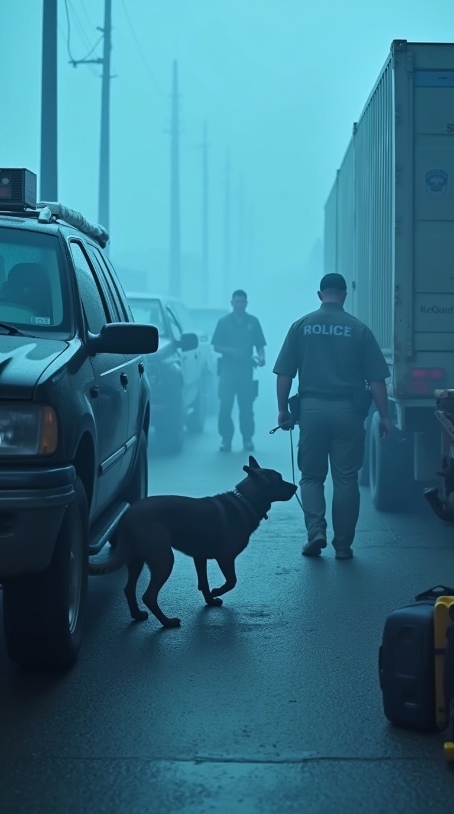
Problem Statement
Drug detection relies on dogs or lab tools
Dogs can be misled by packaging or odor masking
No autonomous detection method exists for open areas
Need for a robust, real-time, field-deployable solution
There are currently no methods for detecting drugs in open areas. A dog may not detect a drug if it is well packaged or another strong smell is introduced. It is impossible to fool a digital gas analyzer.

Slide 3
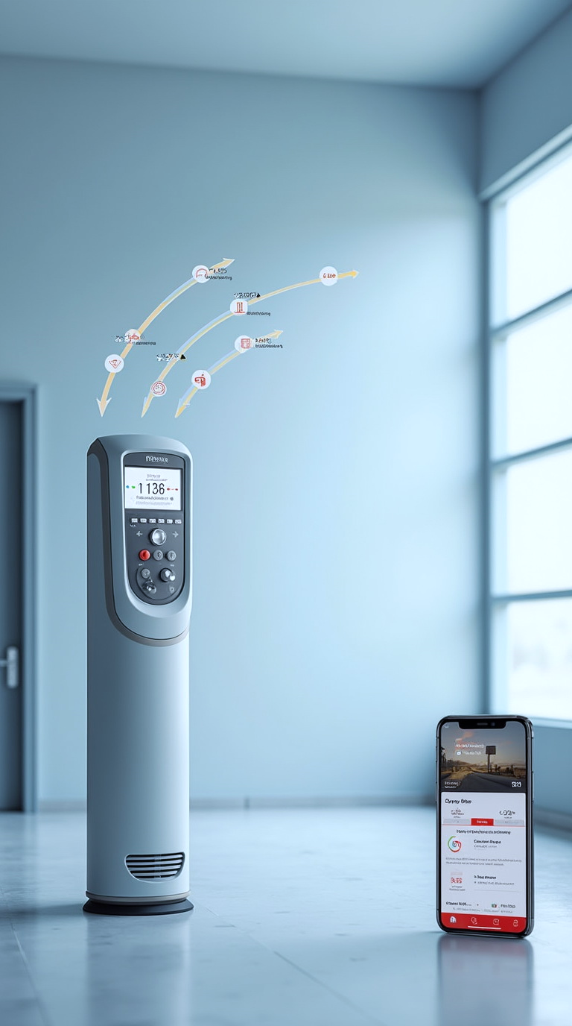
Our Solution
Thermodynamic multi-gas analyzer functions like a digital sniffer dog:
Works 24/7 in open air
Calibrated for specific drug odor profiles
Detects traces through masking
Sends photo + signal via microcontroller
Thermodynamic drug odor multi gas analyzers are calibrated depending from size, shape, mass and valence angle of the drugs hydrocarbon link. They work in open areas like a dog and send a photo from the smell source in 24/7 mode.

Slide 4
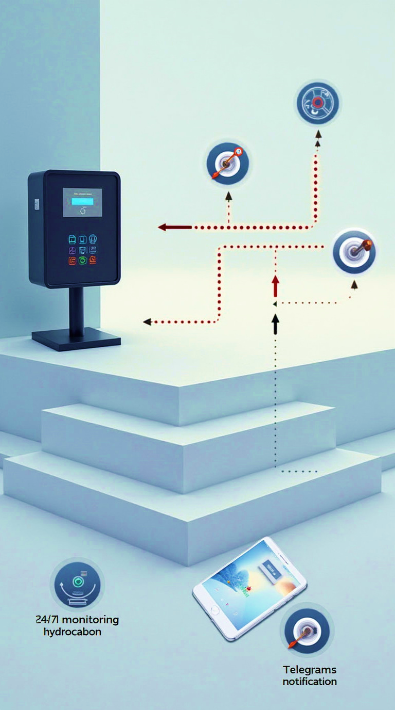
Scientific Principle
Based on thermodynamic odor propagation
Odor depends on mass, shape, valence angle of hydrocarbons
Operates under non-equilibrium diffusion
Experimentally calibrated, not just computed
We calibrate gas detectors depending from drugs smell. We set the microcontroller measurement time depending from spread of the smell in the air. It depends from the size, mass, shape, valence angle of the drug hydrocarbon link. We register the drug smell in open areas like a dog in 24/7 mode.

Slide 5

Early developments
Previously, we made a gas analyzer to determine the degree of infection with codivirus in the open air by human exhalation.
No one has done this before us. The work was published in the central press.
The dependences of the spread of some drugs odors in environment of stagnant air were built.

Slide 6
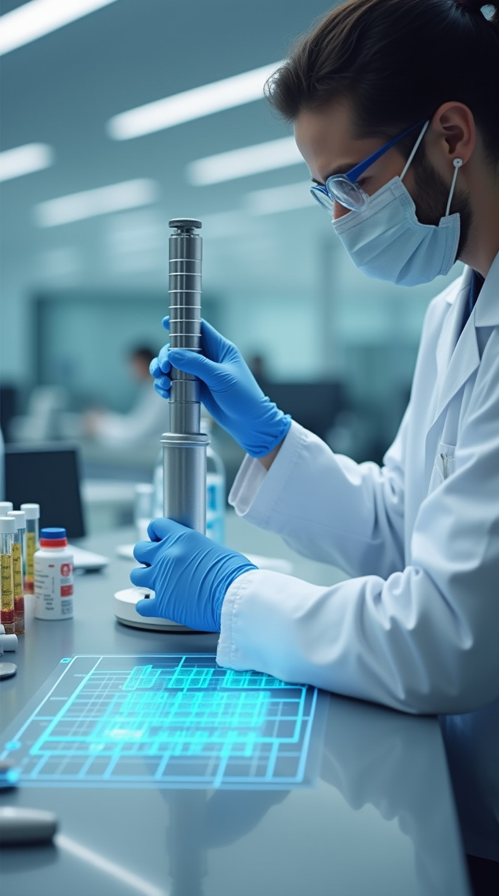
Calibration Method
Custom calibration per drug
Sensor heads tuned via samples
Timing set based on diffusion rates
Considers temperature, humidity, molecule geometry
This project is similar as Neyro network USA Nasal Computer, but unlike it, it was developed based on an experiment and not by calculation.

Slide 7
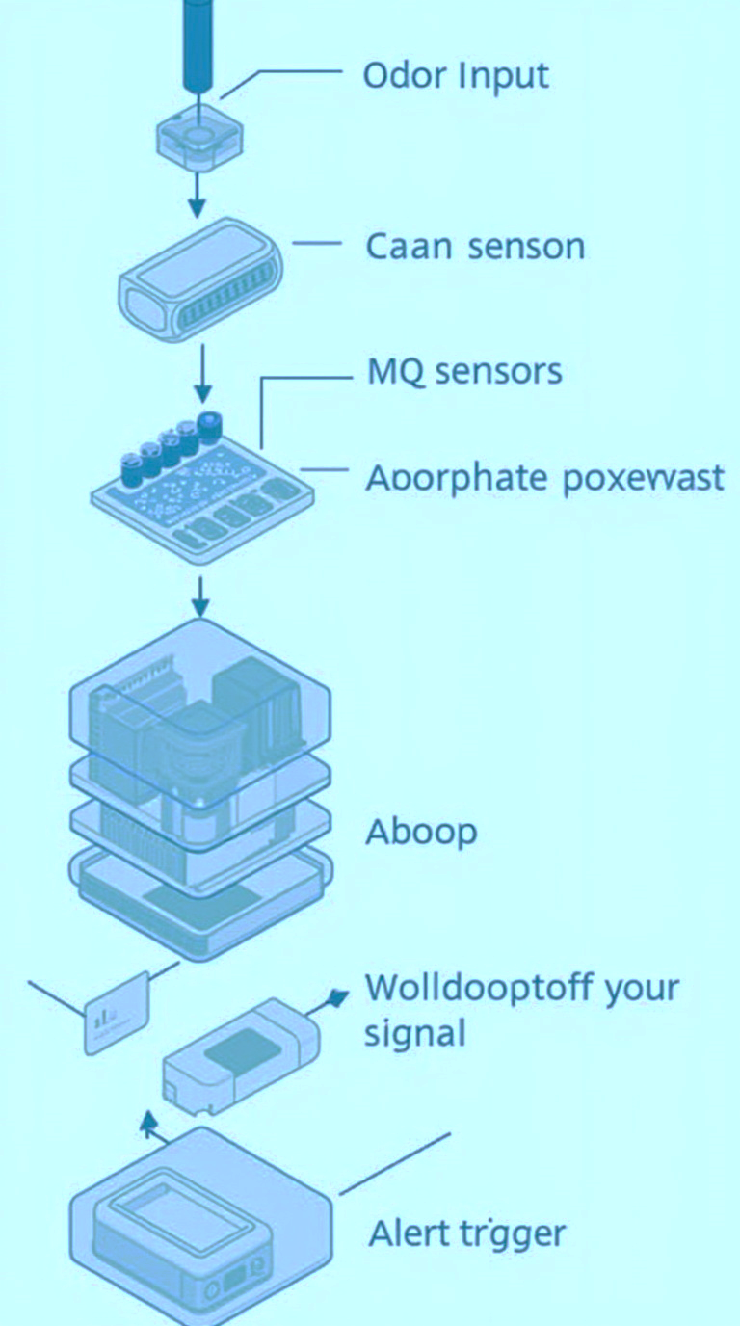
Device Architecture
Hardware:
- MQ sensor array
- Arduino microcontroller
- Power & communication module
Software:
- Signal processing vs calibration curve
- Alert logic (photo + message)
- Cloud/Telegram integration

Slide 8

Use Case:
Open-Area Monitoring
Border zones, customs, public spaces
Detects hidden drugs in cars, luggage, on persons
Operates where dogs and labs fail
Immune to distraction or fatigue
We have an application for a utility model in UkrPatent. Currently, we are at the stage of proposals to government organizations in Ukraine.

Slide 9

Scientific Innovation
Experiment-based design
First to apply odor thermodynamics to drug detection
Built on exhalation analysis tech
Utility model patent filed (UkrPatent)

Slide 10
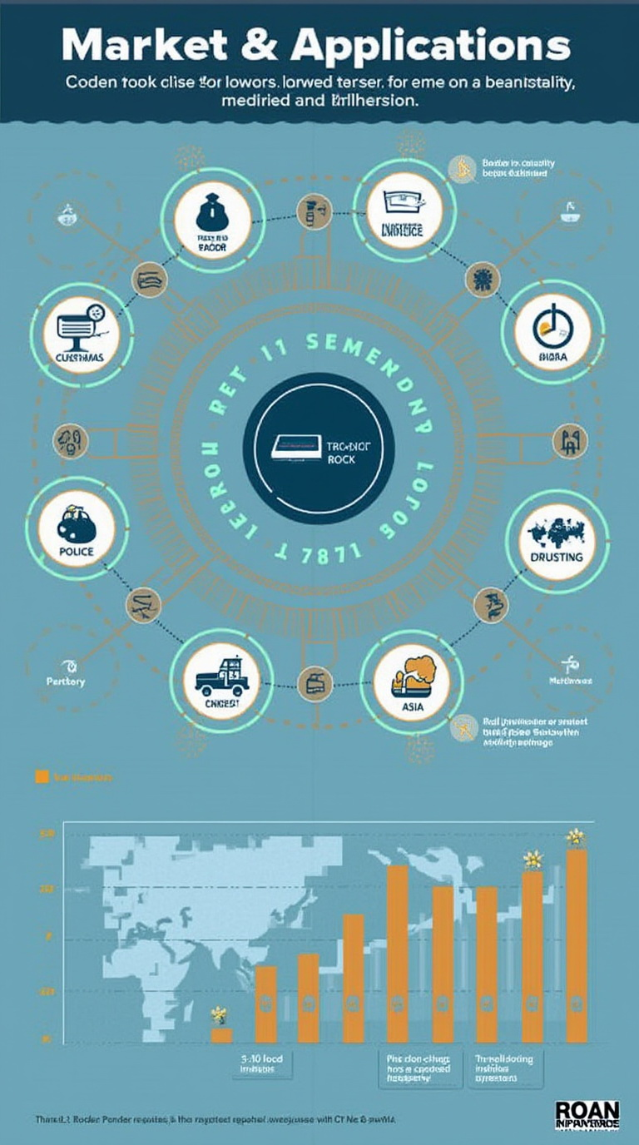
Market & Applications
Global market > €8B (2023)
Annual growth ~6.5%
Clients: customs, police, security
Also: logistics, defense, transport safety
Business model B2B
The global market for solutions detection of hazardous substances exceeds $8 billion (as of 2023).
Expected growth (CAGR): about 6.5% annually.

Slide 11

Roadmap & Investment
Stage: Prototyping done, proposals in progress
Next steps:
• Certification (UA + EU): €20,000
• Initial batch (10 units): €75,000
• Pilot deployments & EU grants
Investment requirements
Certification in Ukraine and the European Union, 20 000 euro
Or + Production of the initial batch (10 devices) €75,000

Slide 12

Team
Prof. Vladyslav Vlastopulo – CEO, thermodynamics expert
Igor Chaadaev – Experiments, programming
Olga Tsaprika – Marketing
Andrey Lukashenko – Math & air physics
Vitaly Svirida – Electronics engineer

Slide 13

Contact & Collaboration
Prof. Vladyslav Vlastopulo
Harvard Marine LCC, Ukraine
vlastopulo0722@gmail.com
+380 99 677 68 23

