Slide 1
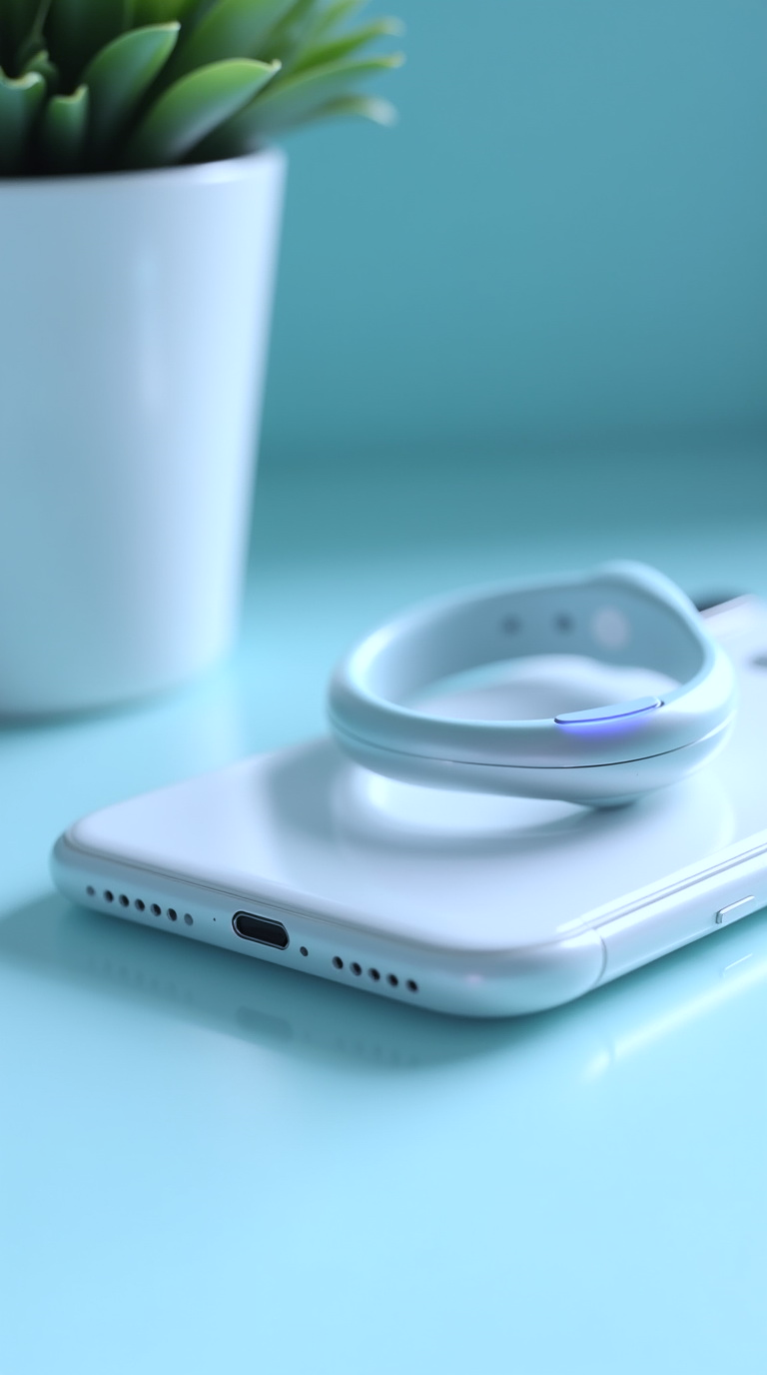
Vibrocapsule Investor Pitch
Smart wearable for attraction, desire, and intimacy
AI-powered pheromone-stimulating capsule + smartwatch

Slide 2

1. Market Problem
Modern couples face decreasing intimacy and desire
Most products are medical or cosmetic, not tech-based
No wearable device connects scent, AI and social interaction

Slide 3
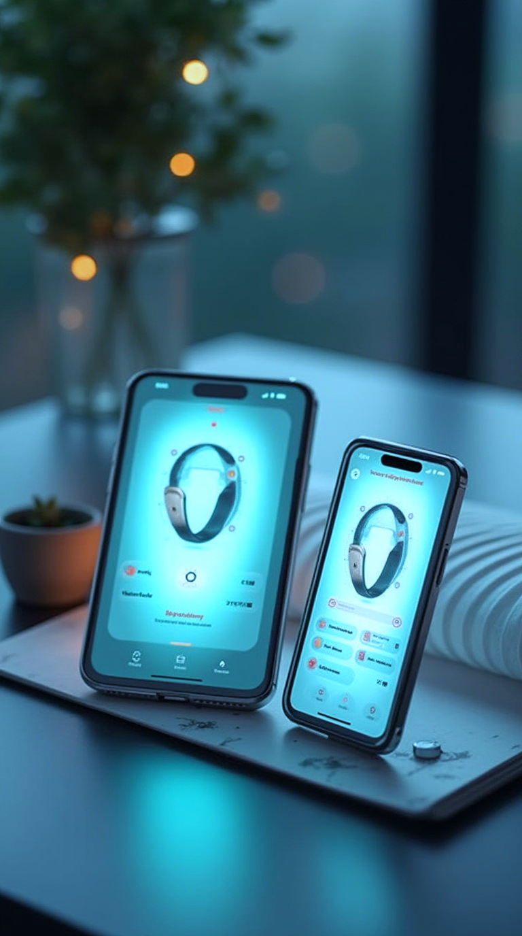
2. Our Solution
Vibrocapsule + smartwatch with mobile app
Stimulates sexual receptors and natural pheromones
AI personalization + gas analyzer validation
Snapchat/WeChat integration for social gamification

Slide 4
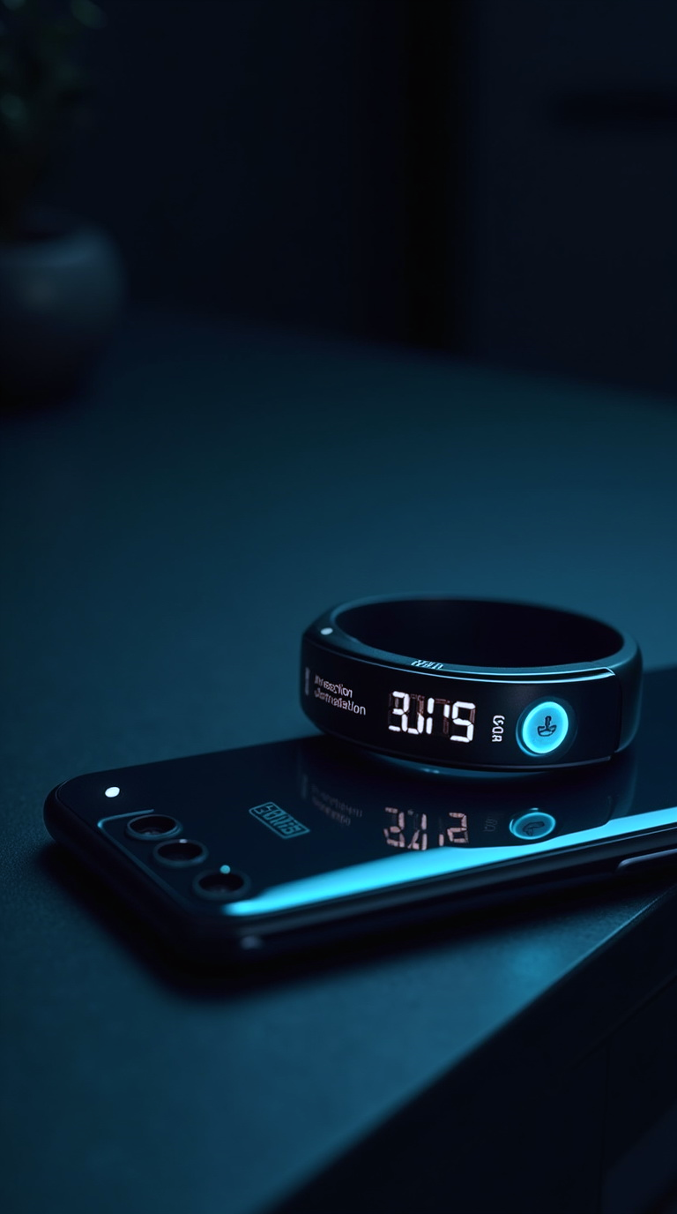
3. Unique Selling Points
Only wearable using real-time pheromone feedback
Not a sex toy – a discreet social health device
Localized branding: 'Harmony Capsule'
Supports both physical and emotional connection

Slide 5
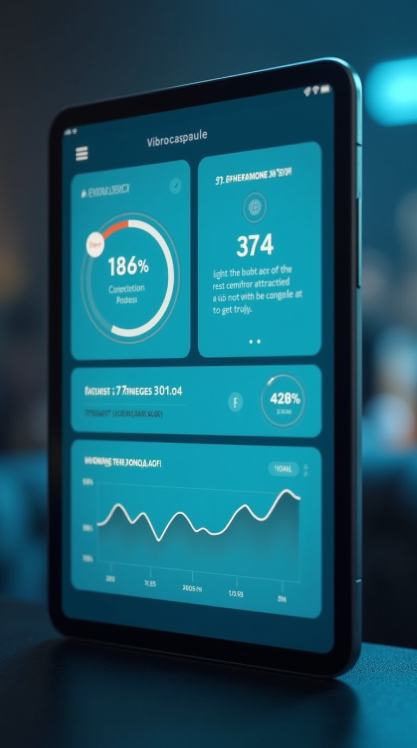
4. Market Size & Growth
SexTech market CAGR: 10.5%,
Expected $80B + by 2030
Europe: 120M active users
USA: 140M active users
China: 300M potential users

Slide 6
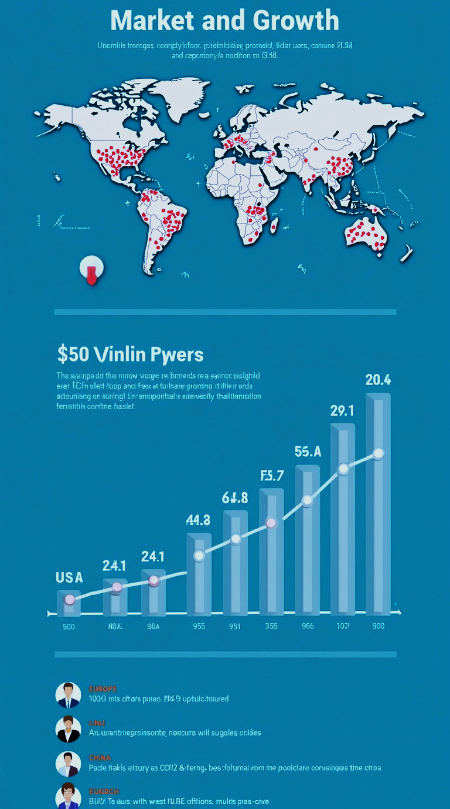
5. Revenue Potential
Europe: up to €108M
USA: up to €136M
China: up to €186M
Total combined: over €430M revenue

Slide 7
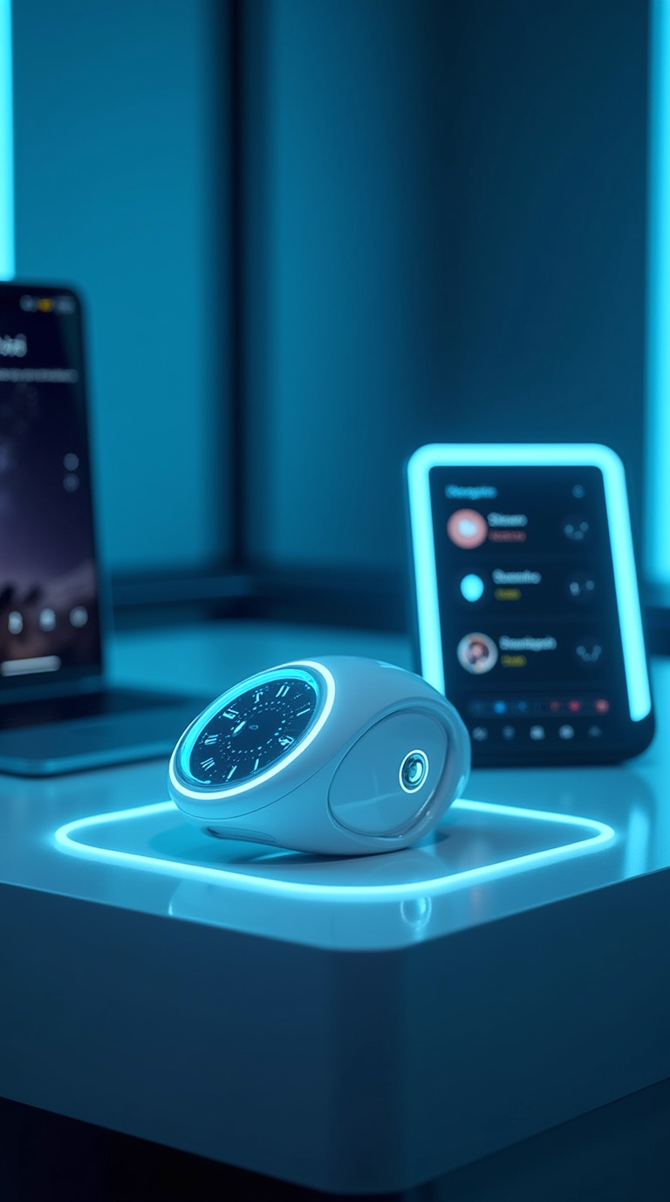
6. Business Model
Retail price range: €79–139 by region
Cost per unit: €5
Gross margin: €74–134 per device
Add-ons: subscription, couple kits, premium capsules

Slide 8

7. Go-to-Market Strategy
Europe/USA: Snapchat, TikTok, wellness influencers
China: WeChat, Douyin, challenges
D2C + marketplaces: Amazon, JD, Shopify
Pharmacy and wellness platforms

Slide 9

8. Roadmap & Milestones
Prototype complete
Patent pending
Positive feedback from early user testing
Launch within 6–8 months after investment

Slide 10
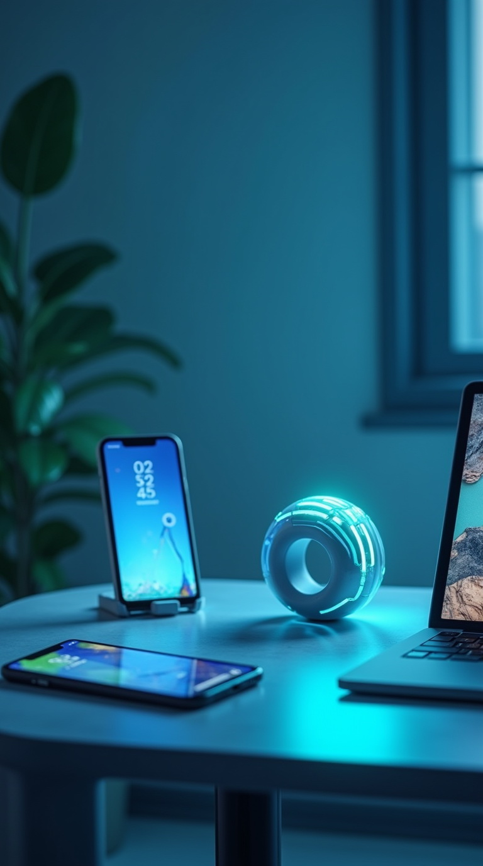
9. Investment Ask
Seeking $300,000
Use: R&D, certification, logistics, marketing
Break-even: 30,000–35,000 units sold
Exit: acquisition or licensing

Slide 11

1. Vladyslav Vlastopulo SEO, Director of Harvard Marine, professor-consultant, Doctor of technical sciences in mechanical engineering, creator of the thermo-elastohydrodynamic theory of lubrication of heavily loaded plain bearings, author of a number of well-known works Elastohydrodynamic theory of lubrication of knee and hip implants, well-known Eslengen Tribological Academy, student of Fedor Snegovsky, currently specializing in tribological, ecological and biomedical engineering. Scientific director of the project.
2. Igor Chaadaev Research engineer, experiment director, artificial intelligence programmer, electronics engineer, microcontroller programmer, gas analyzer equipment developer.
3. Andrey Lukashenko Mathematician, biophysics air engineer.
FOUNDER

Slide 12
4. Vitaly Svirida Senior researcher, electronics engineer, microcontroller programmer, developer of gas analyzer equipment.
5. Sergey Nesterenko Senior researcher, research engineer, experiment director, electronics engineer, microcontroller programmer, developer of gas analyzer equipment.
6. Marina Noskova Biophysics air engineer. Gas Analysis Codivirus Method for Detecting the Threshold of Contagiousness and Therapy Adjustment
OTHERS DEVELOPERS

