Slide 1
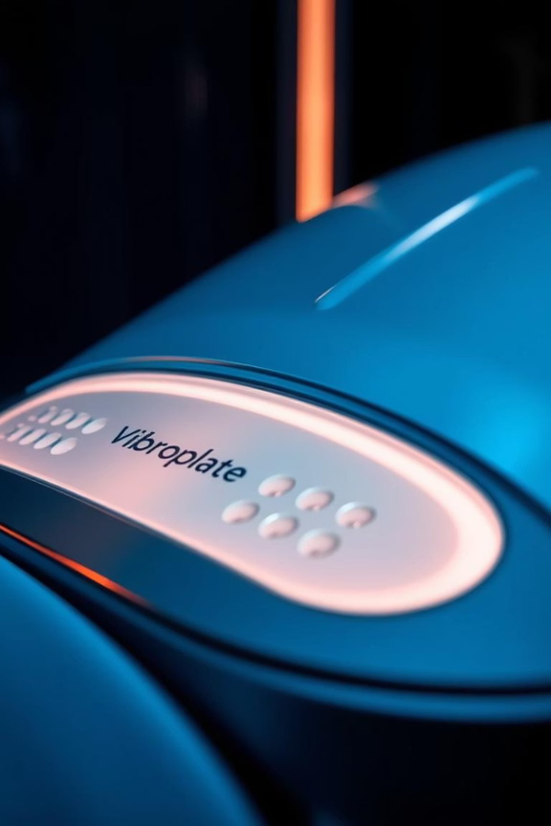

Vibroplate Smart Appetite Control Gadget
Vibroplate introduces an innovative, non-invasive wearable for appetite control. This AI-enabled gadget offers an ultra-affordable solution for managing hunger effectively. It works by stimulating taste receptors to naturally suppress appetite.

Slide 2

Vibroplate: Smart Device for Appetite Control
Wearable Hunger Suppressant
A mini device that curbs appetite via taste receptors.
Affordable and Non-Invasive
Ultra-affordable, non-invasive, AI-enabled technology.

Slide 3

The Problem: Overeating and Portion Control
Widespread Issue
Limited Solutions
Millions struggle with overeating and portion control.
Most diet solutions are digital or supplement-based.
Market Gap
No wearable directly targets physical hunger receptors.

Slide 4
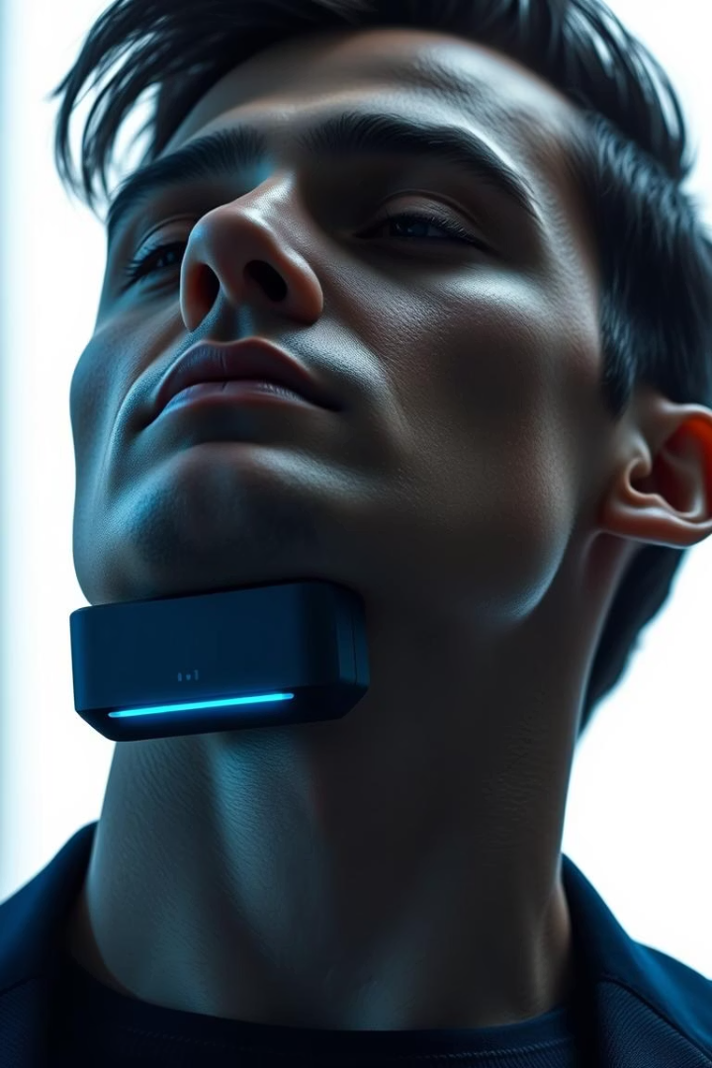



Our Solution: Vibroplate
Taste Receptor Stimulation
Natural Satiety Signal
Reduces Food Intake
Vibroplate stimulates oral taste receptors before meals.
Generates a slight metallic taste, signaling natural satiety.
Daily use significantly reduces food consumption.

Slide 5
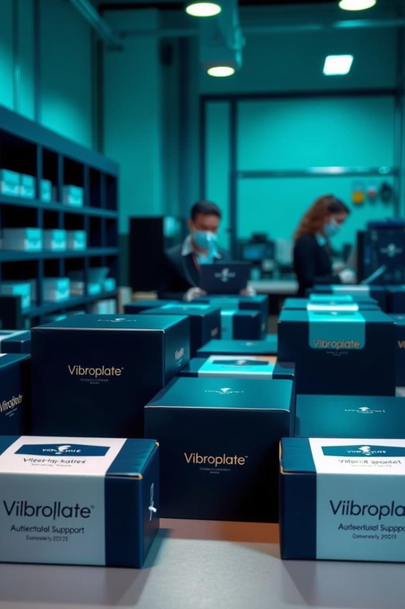




How It Works: Science Behind Vibroplate
Physical Stimulation
Activates taste receptors.
Taste Response
Generates satiety signals.
Brain Registers Fullness
Satiety sensed before eating.
Reduced Appetite
Leads to lower food intake.

Slide 6

Market Opportunity: a $250B + Industry
Vast Market
Target Audience
Viral Potential
Global weight-loss market exceeds $250 billion.
Wellness consumers, impulse buyers, and app users.
Ideal for virality on TikTok and Snapchat platforms.

Slide 7
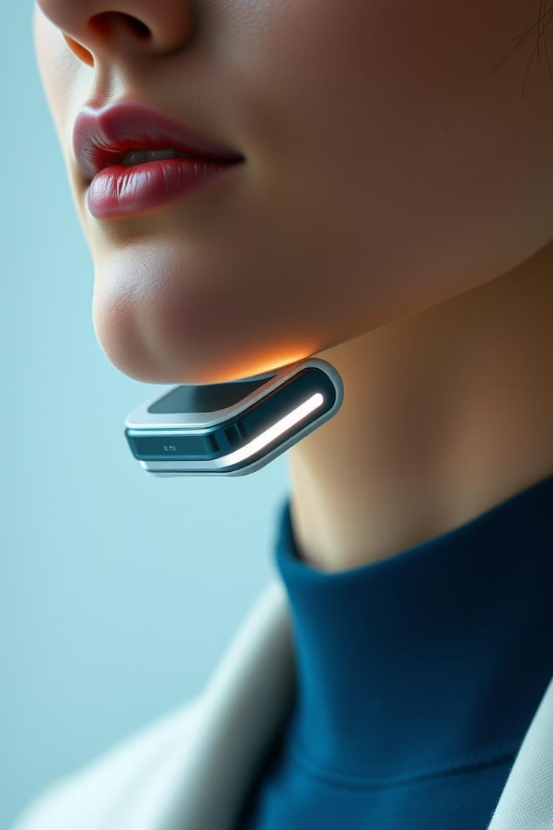
Business Model: Affordable and Accessible
Retail Price
$99
Cost
$11
Margin
$88
Our direct-to-consumer approach leverages social media and affiliate resellers. Wholesale and pharmacy partnerships are also viable options for future expansion.

Slide 8
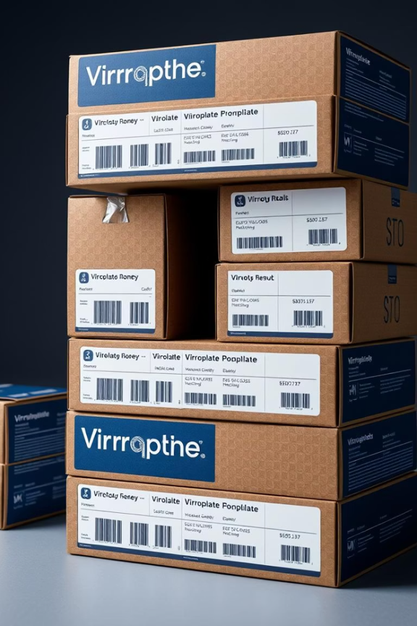
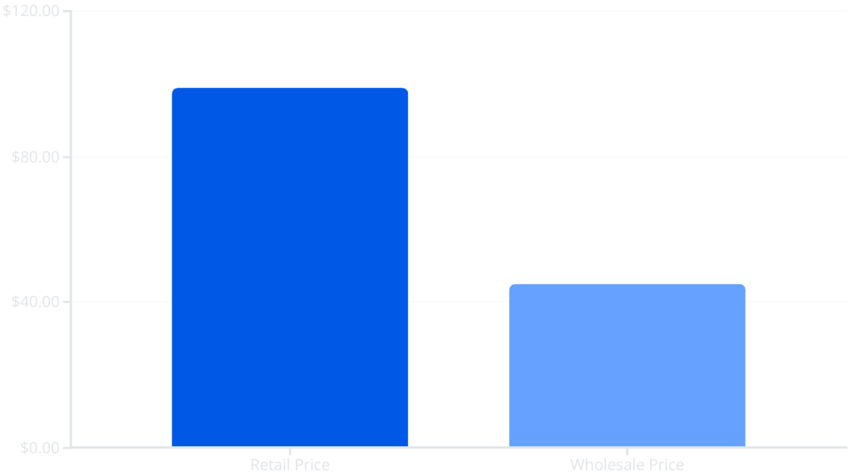
Financial Ask: Seed Funding for Growth
Pricing & Margins
We are seeking $150,000 in seed funding. This investment will cover certification, influencer seeding, and tooling for production. We anticipate breaking even at 50,000–60,000 units sold.
Retail price: $99
Wholesale price: $45–$50
Margin potential up to 50%

Slide 9

Our Team: Driving Innovation Forward
Engineering & R&D
Growth & Marketing
Strategic Partnerships
Based in Ukraine, focusing on core technology.
Operating from EU and USA for market reach.
Collaborating with fitness apps and diet influencers.

Slide 10

Traction & Status: Ready for Launch
Prototype Developed
1
Initial prototype developed in Ukraine.
2
Patent Filed
Intellectual property secured.
Clinical Tests Ongoing
3
Validating efficacy and safety.
4
Manufacturing Partners
Identified for scaling production.
Launch Imminent
5
Ready to launch in 2-3 months.

Slide 11
Founder
1. Vladyslav Vlastopulo Director of Harvard Marine, professor-consultant. Doctor of technical sciences, author of a number of well-known works, currently specializing in tribological, ecological and biomedical engineering. Scientific director of the project.
2. Igor Chaadaev Research engineer, experiment director, artificial intelligence programmer, electronics engineer, microcontroller programmer, gas analyzer equipment developer.
3. Vitaly Svyryda General developer of the gas analyzer.
4. Andrey Lukashenko Mathematician, biophysics air engineer.
5. Victor Michaylov SAAS programmer, IT specialist.

Slide 12
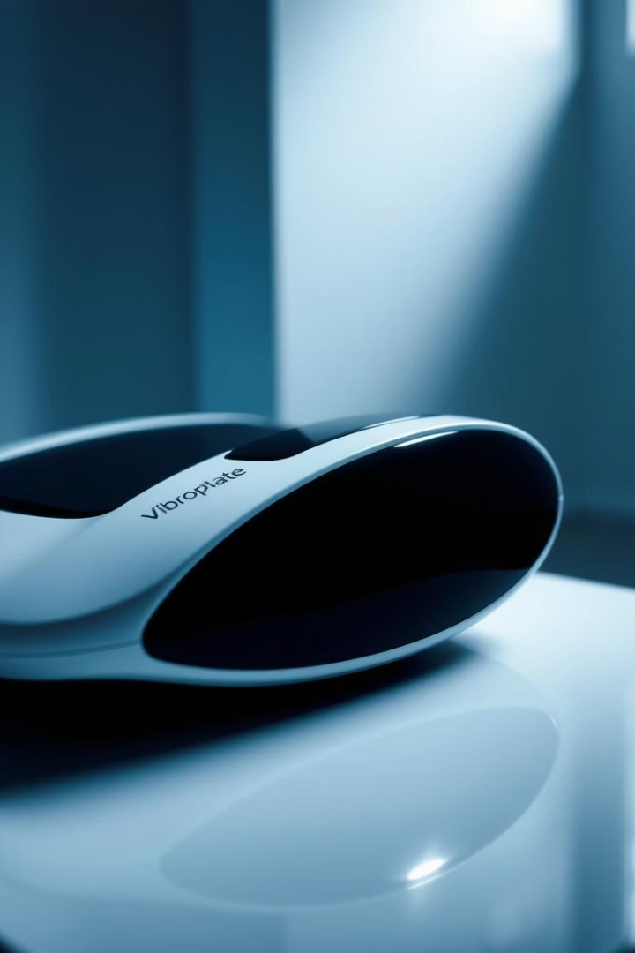
List of participants
1. (Coordinator) | Harvard Marin LCC | Ukraine
Contacts
Email: vlastopulo0722@gmal.com
Phone: +380-996776823

