Slide 1
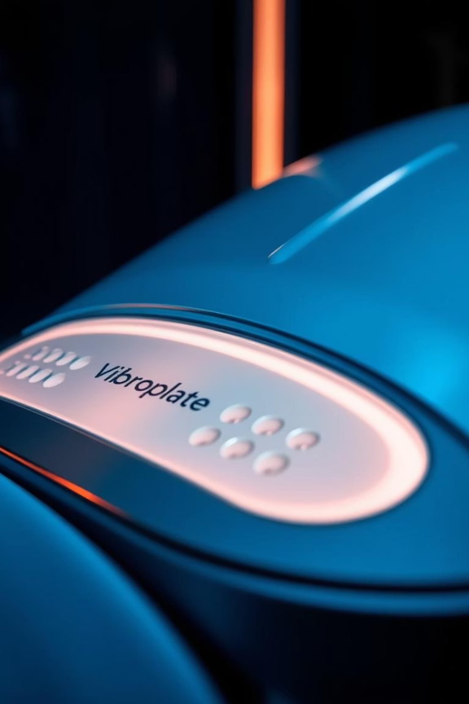

Vibroplate – Product Overview for Partners
Welcome, dear partners, buyers end distributors !
We're excited to introduce Vibroplate, a revolutionary smart device poised to redefine appetite control and healthy living. This presentation will cover product essentials, market advantages, and partnership opportunities.
Presentation for wholesale buyers/distributors

Slide 2

Introducing Vibroplate: Smart Appetite Control
Smart Device
Advanced tech for appetite reduction
Controls Cravings
Helps manage food desires naturally
Ultra-Affordable
Low entry cost for consumers
Low-Risk Entry
Easy addition to product lines

Slide 3
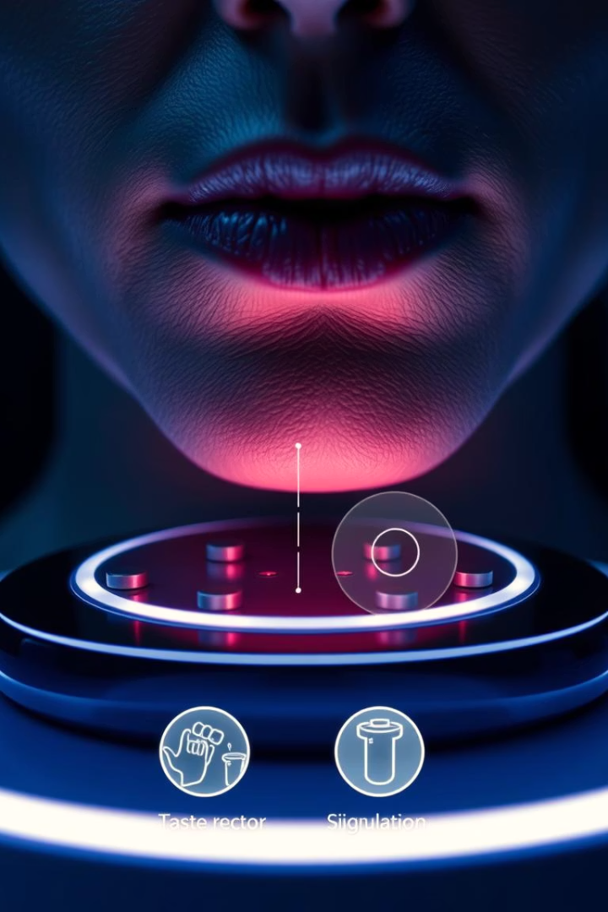



What is Vibroplate?
Taste-Receptor Stimulator
Worn comfortably under the chin
Induces Satiety
Creates fullness feeling before meals
Optimal Use
1–3 times daily before eating

Slide 4

Key Benefits: Safe & Effective
No Drugs, No Supplements
Biological Feedback
Works via taste and brain connection
Natural approach to appetite control
Safe, Silent, Discreet
User-friendly and inconspicuous

Slide 5

Pricing & Margins: High ROI Potential
$99
$44–$55
Retail Price
Wholesale Price
Attractive consumer price point
Competitive partner pricing
High
Bundles
B2C Potential
Versatile Product
Significant volume opportunities
Ideal for kits or product bundles

Slide 6
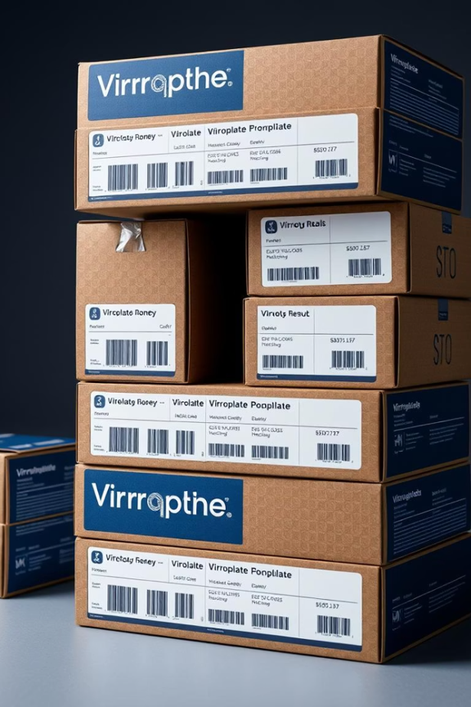
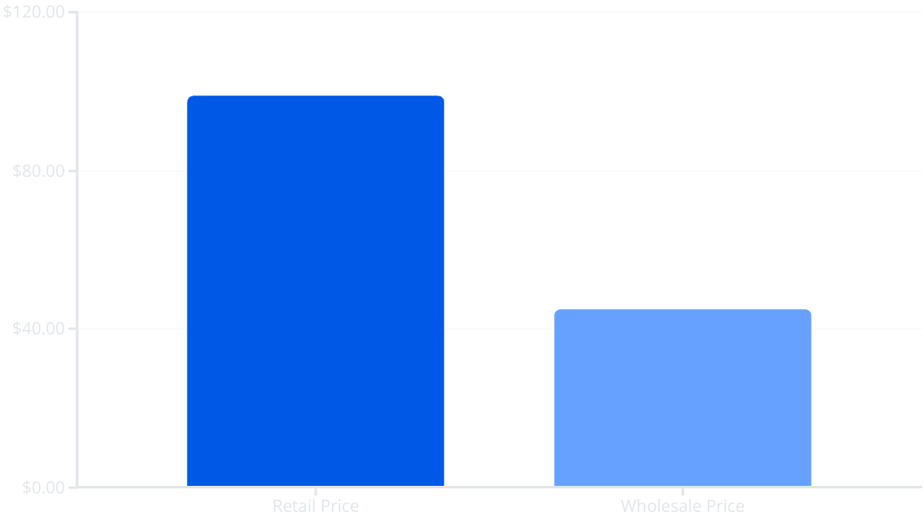
Pricing & Margins
Retail price: $99
Wholesale price: $45–$50
Margin potential up to 50%

Slide 7

Ideal Sales Channels
Retail Locations
Digital Platforms
Specialty Sales
Wellness shops
TikTok / Snapchat stores
Impulse-buy stands
Pharmacies
Affiliate dropship
Subscription add-on to diet apps

Slide 8
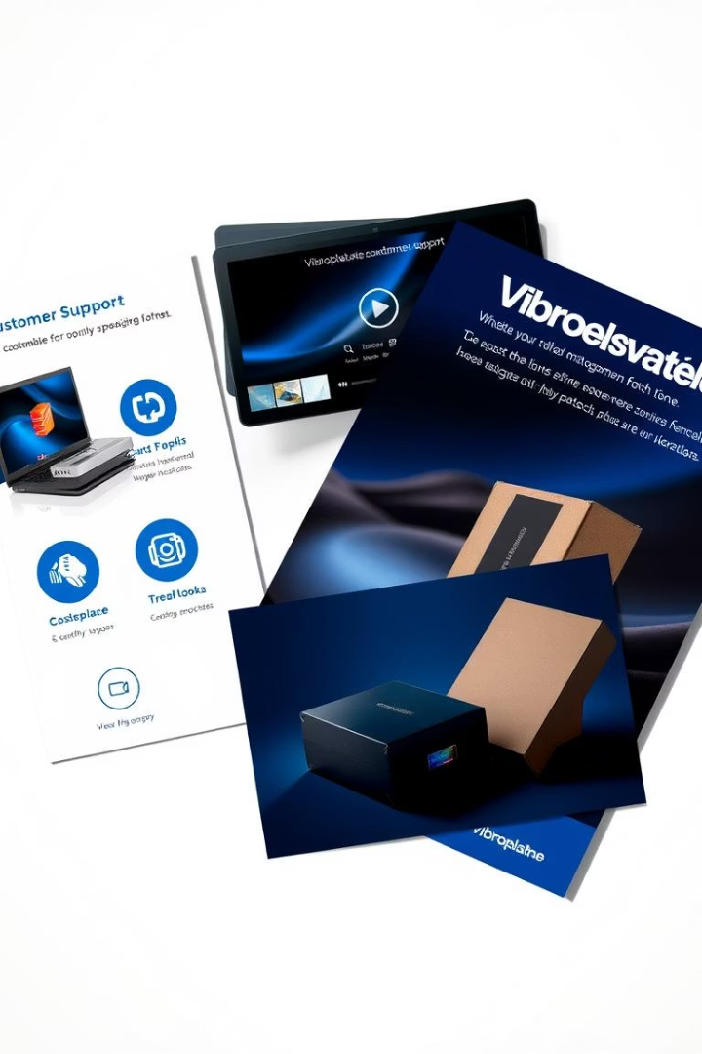



Support & Customization
Marketing Assets
Ready-to-use visuals and content
Customization
Private label and packaging options
Quick Logistics
Efficient manufacturing in Ukraine/Poland

Slide 9

Why Add Vibroplate?
Next Steps
Innovative Wearable
Low Cost, Minimal Risk
Contact our sales team today
Cutting-edge appetite control
Accessible entry point
Discuss your specific needs
Begin your partnership journey
High ROI Potential
Ideal Portfolio Addition
Strong profit opportunities
Enhances weight-loss offerings

Slide 10
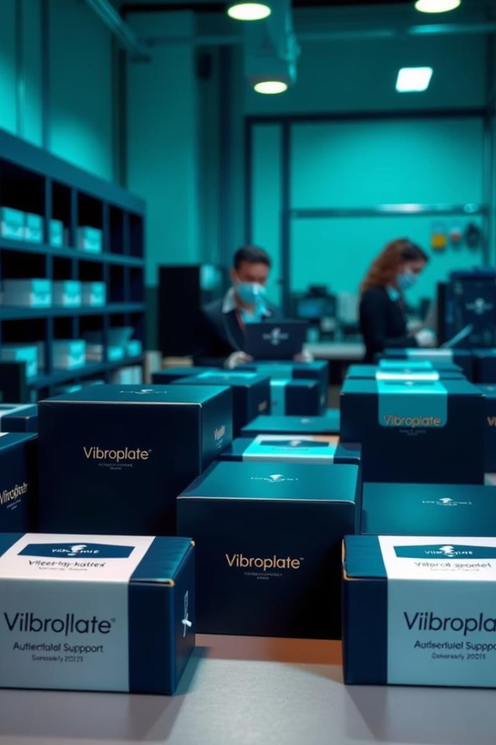
Founder
1. Vladyslav Vlastopulo
Director of Harvard Marine, professor-consultant. Doctor of technical sciences, author of a number of well-known works, currently specializing in tribological, ecological and biomedical engineering. Scientific director of the project.
2. Igor Chaadaev
Research engineer, experiment director, artificial intelligence programmer, electronics engineer, microcontroller programmer, gas analyzer equipment developer.
3. Vitaly Svyryda
General developer of the gas analyzer.
4. Andrey Lukashenko
Mathematician, biophysics air engineer.
5. Victor Michaylov
SAAS programmer, IT specialist.

Slide 11
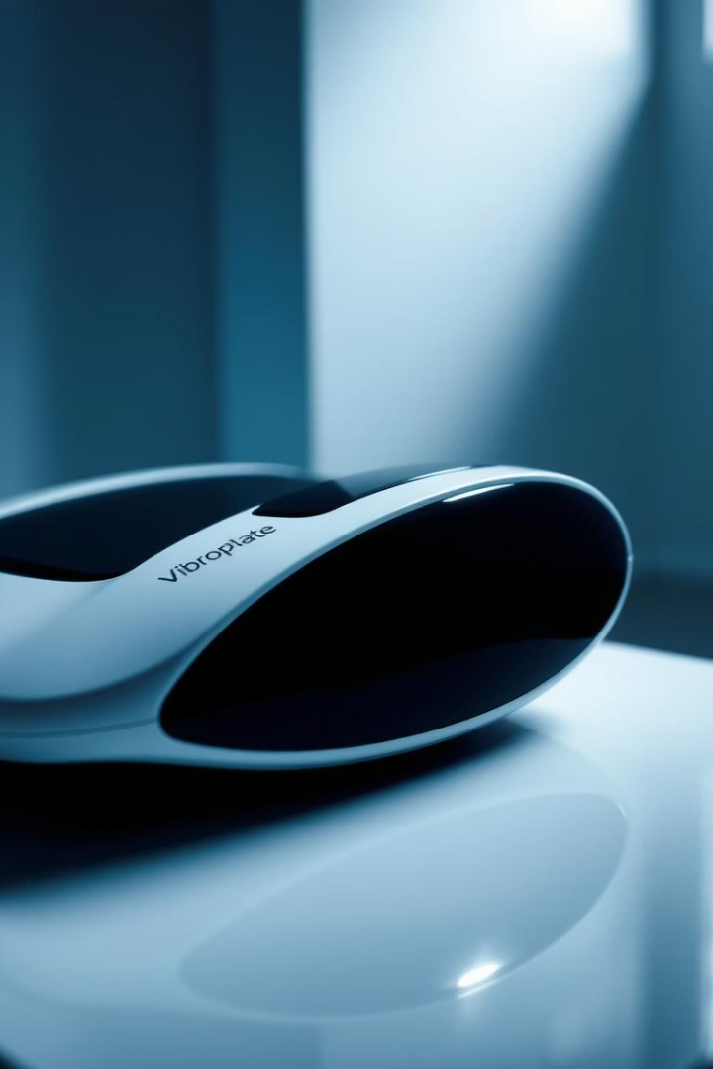
List of participants
1. (Coordinator) | Harvard Marin LCC | Ukraine
Contacts
Email: vlastopulo0722@gmal.com
Phone: +380-996776823

